Slide 1
DOI Creation And Citation
(Team NanChan)

Slide 2
Problem Statement
In the existing landscape of academic research, the absence of a consolidated platform for dataset uploads, DOI creation, and research paper submissions poses a significant challenge.
The need for a unified portal becomes evident as researchers navigate multiple platforms, hindering seamless collaboration and standardization.
Our project aims to address this challenge by providing a centralized space where researchers can efficiently upload datasets, generate DOIs, and submit research papers—all within a unified and user-friendly environment. This initiative seeks to streamline academic processes, enhance collaboration, and simplify the management of crucial components in research endeavors.

Slide 3
Overview
The "DOI Creation and Citation" system is a robust platform designed to facilitate the seamless management of datasets, licenses, and citations within the realm of research papers.
Offering a suite of functionalities, the system ensures efficient DOI generation, customizable templates for data and license use agreements, citation tracking, and more.
The primary objective is to provide researchers with an intuitive and standardized platform for managing and referencing datasets in research papers.

Slide 4



Tech Stack

Slide 5
Features
Authenticated entry into the portal.
Can add datasets into the portal. A unique DOI is generated for every dataset to track its citation.
Can choose a license for the dataset from the available options or create a custom template.
Privileged admin role that accepts or denies the custom template to be added into the portal for future purposes.
Citations for datasets generated in Vancouver, BibTeX, and American and are copied to clipboard for faster citation.
Can add research papers into the portal. Adobe Extract PDF API is used to extract text from pdf uploads.
Can download the datasets and view the research papers on the portal. Each license for the dataset shows more information about the license terms.

Slide 6
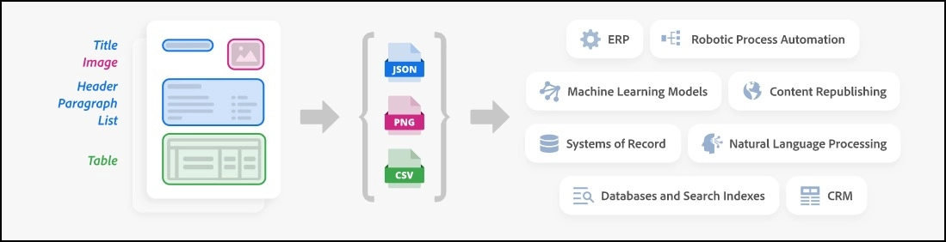
About Adobe Extract Pdf API

Slide 7
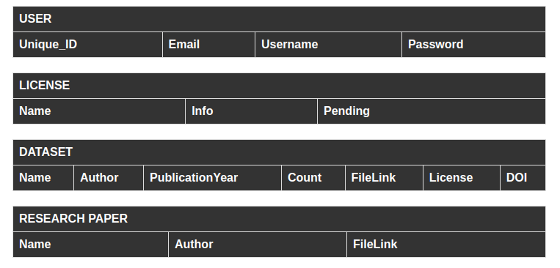
Database Schema

